Slide 1
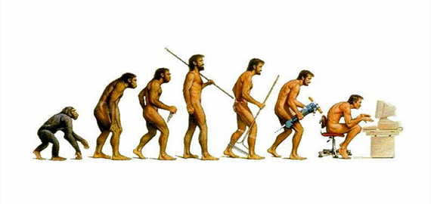
Evolver
Bob Edgar and Arend Sidow
Stanford University

Slide 2
Motivation
Genomics algorithms
Whole-genome alignment
Ancestral reconstruction
Accuracy unknown
Simulation required
No realistic whole-genome simulator

Slide 3
Evolver
Sequence evolution simulator
Whole mammalian genome
Mutations
All length scales
Single base substitutions…
…to chromosome fission and fusion
Constraint
Gene model and non-coding elements

Slide 4
Mutations
Substitute
Delete
Copy
Tandem or non-tandem
Expand/contract simple repeat array
Move
Invert
Insert
Random sequence
Mobile element
Retroposed pseudo-gene

Slide 5
Length-dependent rates
Any number of (Length,Rate) pairs given as input
Rate
Missing values computed by linear interpolation
Zero rate if
L > max given
1 2 3 4 5 6 7 8
Length
Total rate = sum of bar heights

Slide 6
Annotation
Non-Exon
Conserved Element
Gene
START
START
STOP
STOP
UTR
UTR
UTR
CDS
CDS
CDS
CDS
CDS
CDS
UTR
NXE
UTR
NXE
Neutral
NXE
NXE
Neutral
donor
donor
acceptor
acceptor
donor
donor
acceptor
acceptor
donor
donor
acceptor
acceptor
Neutral
NGE
NGE
CpG
Non-Gene Conserved Element
Simple repeat
CpG island

Slide 7
Constraint
Every base has “accept probability” P^{Accept}
Probability that a mutation is accepted
Same for all mutations (subst., delete, insert...)
Special cases for coding sequence
20x20 amino acid substitution probability table
Accept prob = P^{Accept}_{1st base in codon} x P_{a.a. accept}
Frame preserved

Slide 8
Rejection
Events proposed at fixed rates (neutral)
Locus selected at random, uniform distribution
Accept probability computed from P^{Accept}’s
Multiple bases = product
Equivalent to accept (mutate 1 AND mutate 2 ... )
P^{Accept} = 0.8 x 0.5 = 0.4
0.3
0.8
0.5
0.4
A
G
C
T

Slide 9
Gene model
Coding sequence (CDS)
Amino acid substitution, frame preserved
UTRs
Splice sites
2 donor, 2 acceptor sites with P^{Accept}=0
Non-exon elements (NXEs)
P^{Accept}<1, no other special properties

Slide 10
Non-gene conserved elements
Non-gene elements (NGEs)
P^{Accept}<1, no other special properties

Slide 11
Mobile elements
Initial library of sequences
Updated regularly—MEs evolve
Faster rate than host
Using intra-chromosome Evolver
Birth/death process
Terminal repeats special-cased
Per-ME parameters for insert rate etc.

Slide 12
Retro-posed pseudo-genes
Inserted like mobile elements
Birth/death process for active RPGs
Regular updates:
Genes selected at random from genome
Spliced sequence computed
Added to mobile element/RPG sequence library

Slide 13
Gene duplication
Triggered by any inter- or intra-chromosome copy of complete gene
 | New Slower | New Same | New Faster | New Disabled
Old Slower | 5 | 8 | 8 | -
Old Same | 20 | 20 | 20 | 200
Old Faster | 50 | 15 | 50 | -
Old Disabled | - | 25 | 10 | -

Slide 14
Constraint change events
Change annotation, not sequence
CEs created, deleted and moved
CpG islands created, deleted and moved
CE speed change (P^{Accept}’s changed)
Gene duplication
Side-effect of copy
Gene loss
Special case handled between cycles

Slide 15
Gene structure changes
Move START
Move STOP
MoveStartCodonIntoUTR
MoveStopCodonIntoCDS
Move translation terminal
MoveStartCodonIntoCDS
MoveStopCodonIntoUTR
MoveUTRTerm
MoveUTRTerm
Move transcription terminal
UTR
UTR
CDS
CDS
CDS
UTR
Move Acceptor
MoveAcceptorIntoUTR
MoveAcceptorIntoCDS
MoveUTRAcceptorIntoIntron
MoveCDSAcceptorIntoIntron
Move splice site
MoveUTRDonorIntoIntron
MoveCDSDonorIntoIntron
Move
Donor
MoveDonorIntoUTR
MoveDonorIntoCDS
Move UTR splice
Move CDS splice

Slide 16
Alignments
Homology to all ancestors is tracked
Relationships not tracked:
Ancestral paralogy
E.g. segmental duplications already present
Mobile elements
Retroposed pseudo-genes
Output: ancestor-leaf and leaf-leaf

Slide 17
Alignments
Align residues if:
Homologous
and no intervening duplication before MRCA
Avoids problem of ancestral paralogy
Probably the most biologically informative
Does align segmental duplications
Does align tandem duplications
Silly for very short tandems, need to filter

Slide 18
Ancestral genome
Model organism
Human (hg18)

Slide 19
Ancestral annotations
UCSC browser tracks
CDS, UTR, CpG islands
Splice sites inserted at terminals of all introns
Simple repeats
Tandem Repeat Finder
Non-exon and non-gene elements
Generated according to stochastic model

Slide 20
Generating NGEs and NXEs
Length histogram as for event rates
Cover 7% of genome with random CEs
Frequency
1 2 3 4 5 6 7 8
Length

Slide 21
Generating NGEs and NXEs
Assign ~50% to genes
NXE if distance < d
NGE if distance > d
CDS
CDS
CDS
CDS
UTR
UTR
NXE
NGE
CDS
CDS
CDS
CDS
UTR
NGE
UTR
d = approx ¼ of inter-gene distance (selected from normal distribution)

Slide 22
Validation
Simulate “human-mouse” and “human-dog”
Ancestor (hg18)
0.24
0.40
0.17
“dog”
“mouse”
“human”

Slide 23
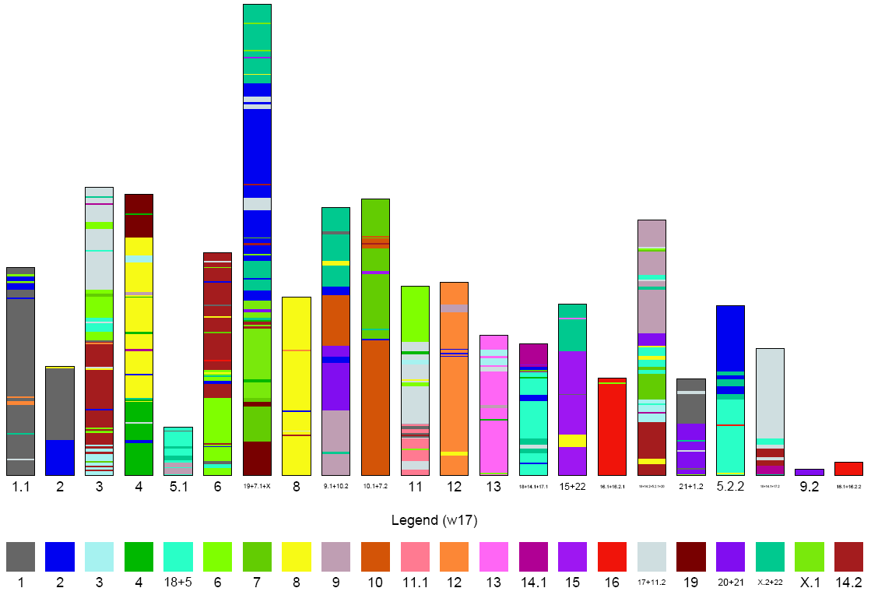
Simulated human-mouse

Slide 24
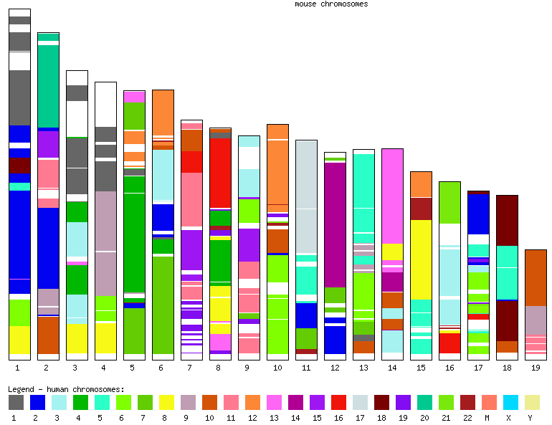
Real human-mouse

Slide 25
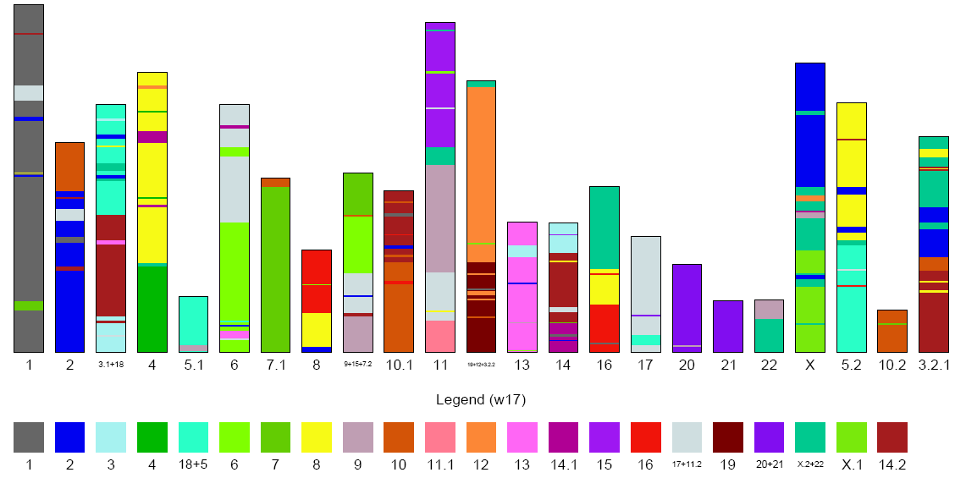
Simulated human-dog

Slide 26
Real human-dog

Slide 27
hg18
“Human”
“Dog”
“Mouse”

Slide 28
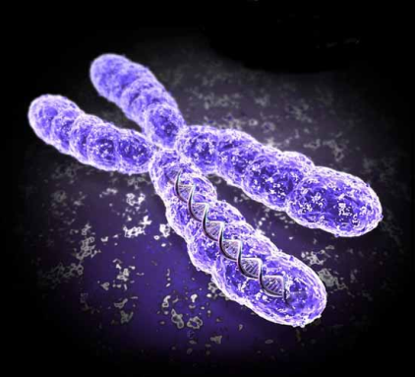
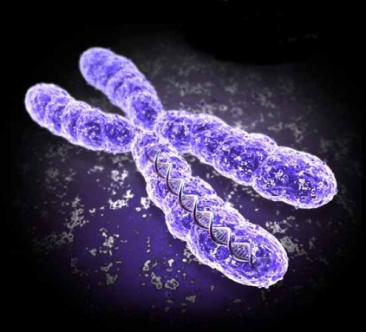
Evolver modules
Intra-chromosome
Substitute
Move
Copy
Invert
Delete
Insert
Inter-chromosome
Move
Copy
Split
Fuse

Slide 29
Cycles
Intra Chr 1
Intra Chr 1
Intra Chr 2
Intra Chr 2
Inter
Inter
Intra Chr N
Intra Chr N
One cycle

Slide 30
Time
0.01 subs/site cycle = 1 CPU day
ENCODE tree (30 mammals) = 500 CPU days

Slide 31
Memory and file sizes
RAM: 40 bytes/base
100 Mb chromosome RAM = 4 Gb
Human chr.1 (240 Mb) RAM = 12 Gb
Alignment files
Custom highly compressed binary format
Standard formats too big (many short hits)
Grow with distance
“Human-mouse/dog” distance ~0.5 subs/site
Alignment files ~5 Gb

Slide 32
Collaborators
George Asimenos
Serafim Batzoglou

Slide 33
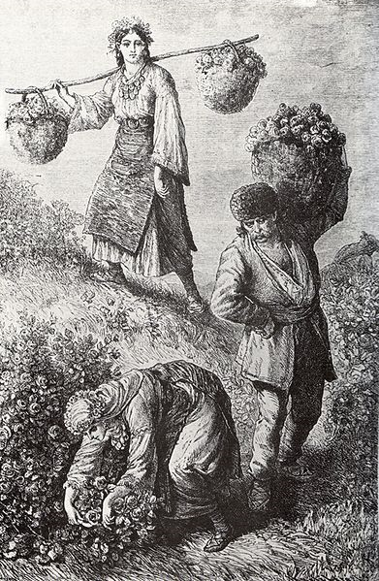
Thank you.
Rose-picking in the Rose valley near the town of Kazanlak in Bulgaria, 1870s, engraving by an Austro-Hungarian traveler Felix Philipp Kanitz. Published in his book "Donau Bulgarien und der Balkan” Leipzig, 1879, p. 238.

